Slide 1
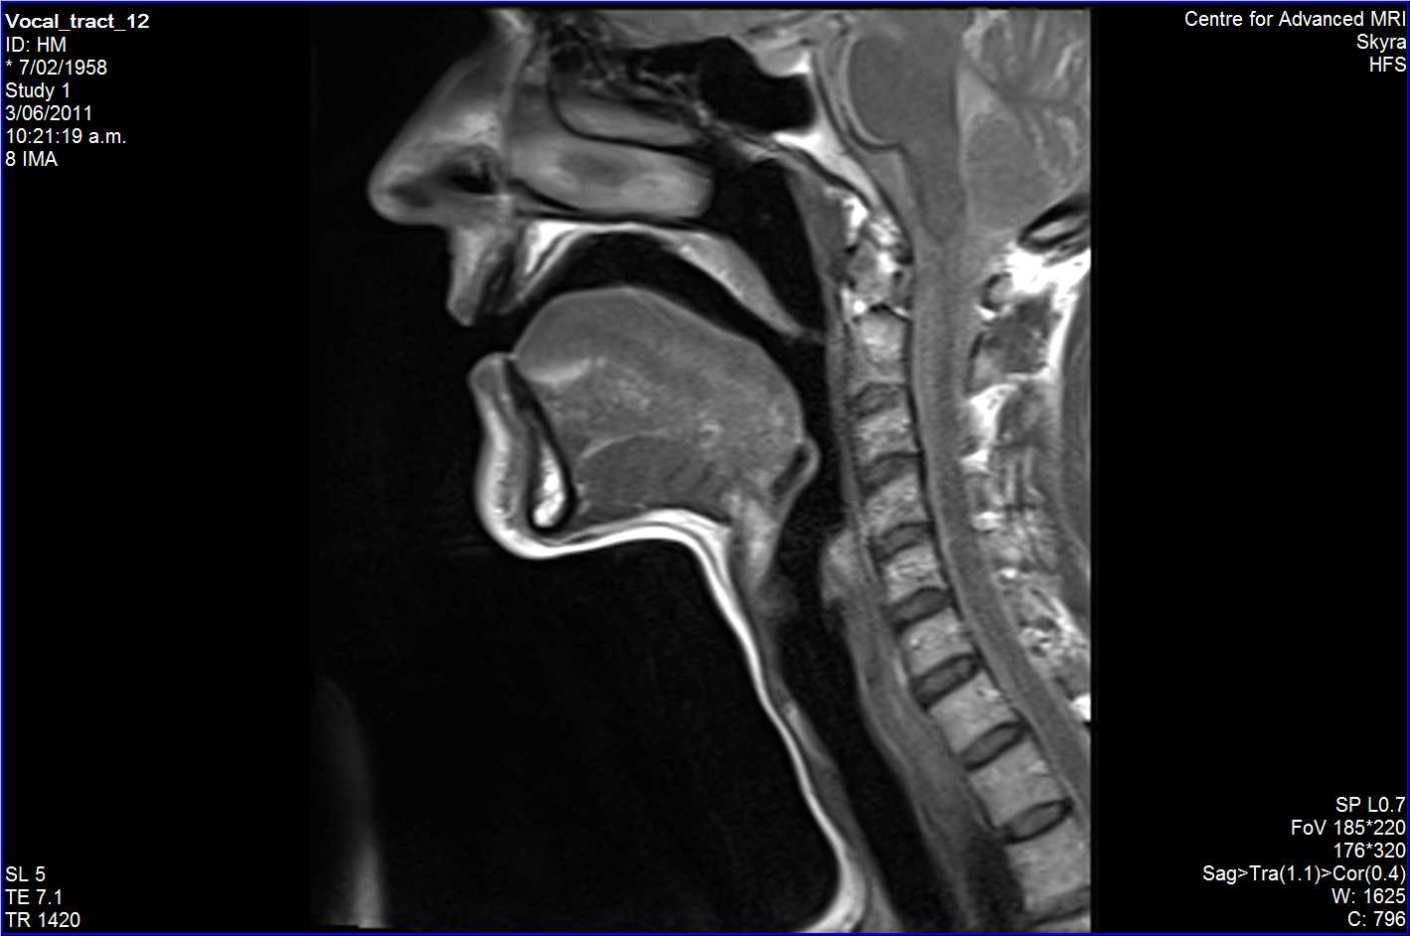
Notes:
Rest

Slide 2
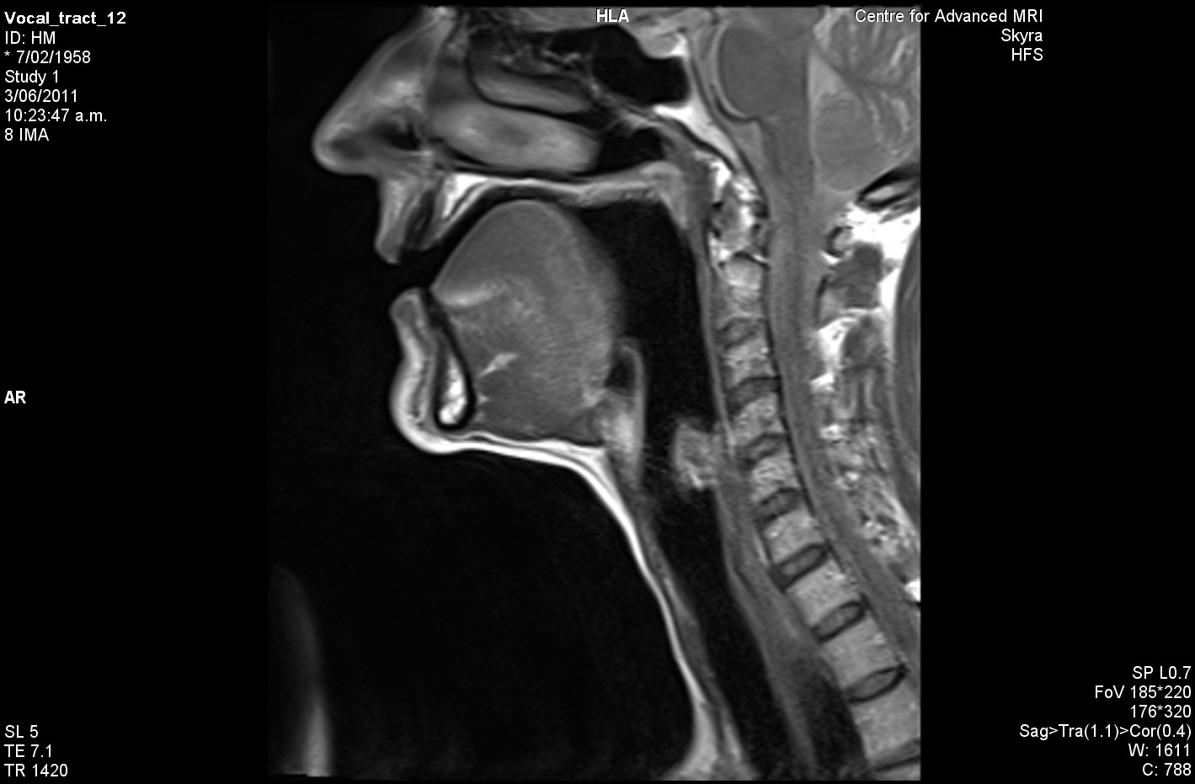
Notes:
HEED

Slide 3

Notes:
HEAD

Slide 4
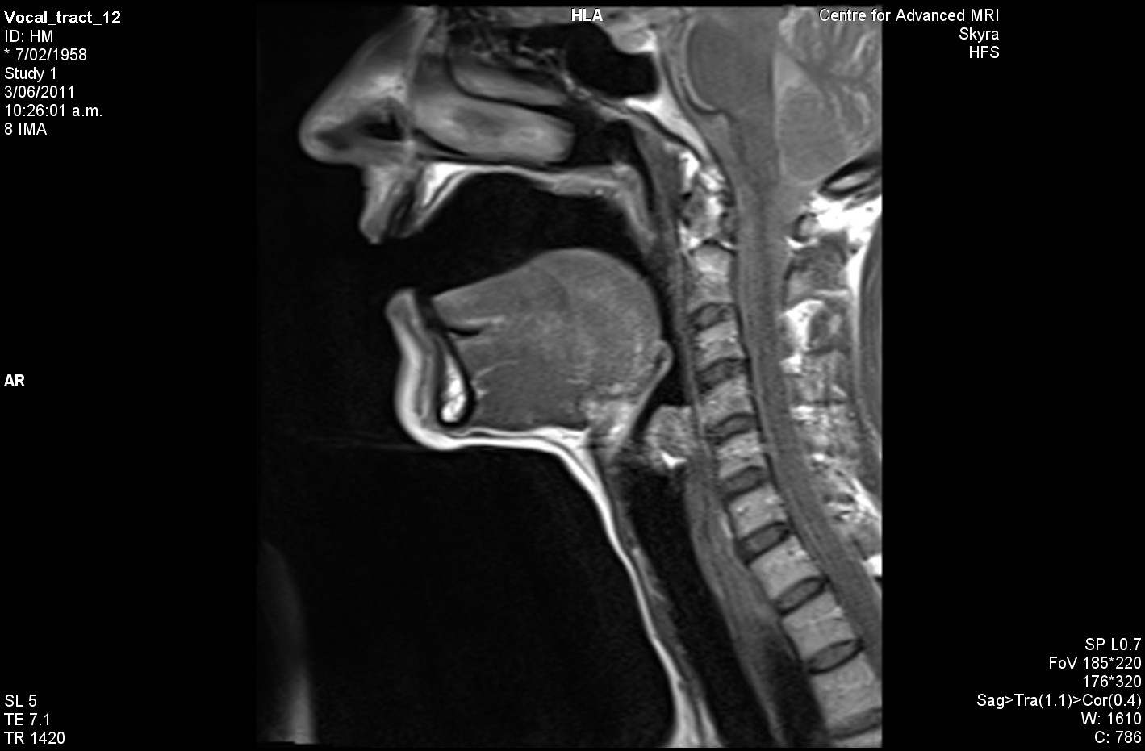
Notes:
HARD

Slide 5
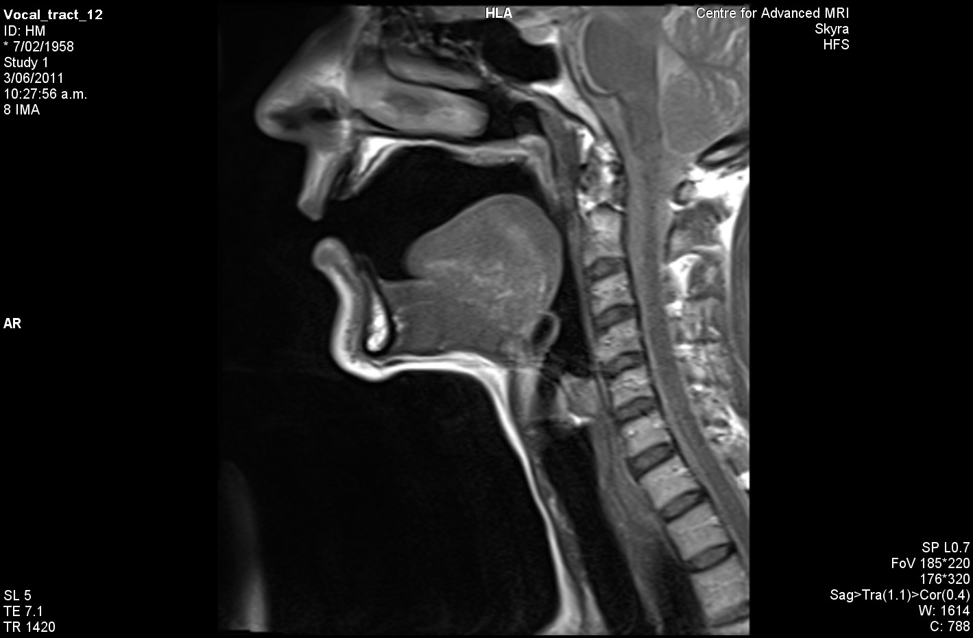
Notes:
HOARD

Slide 6
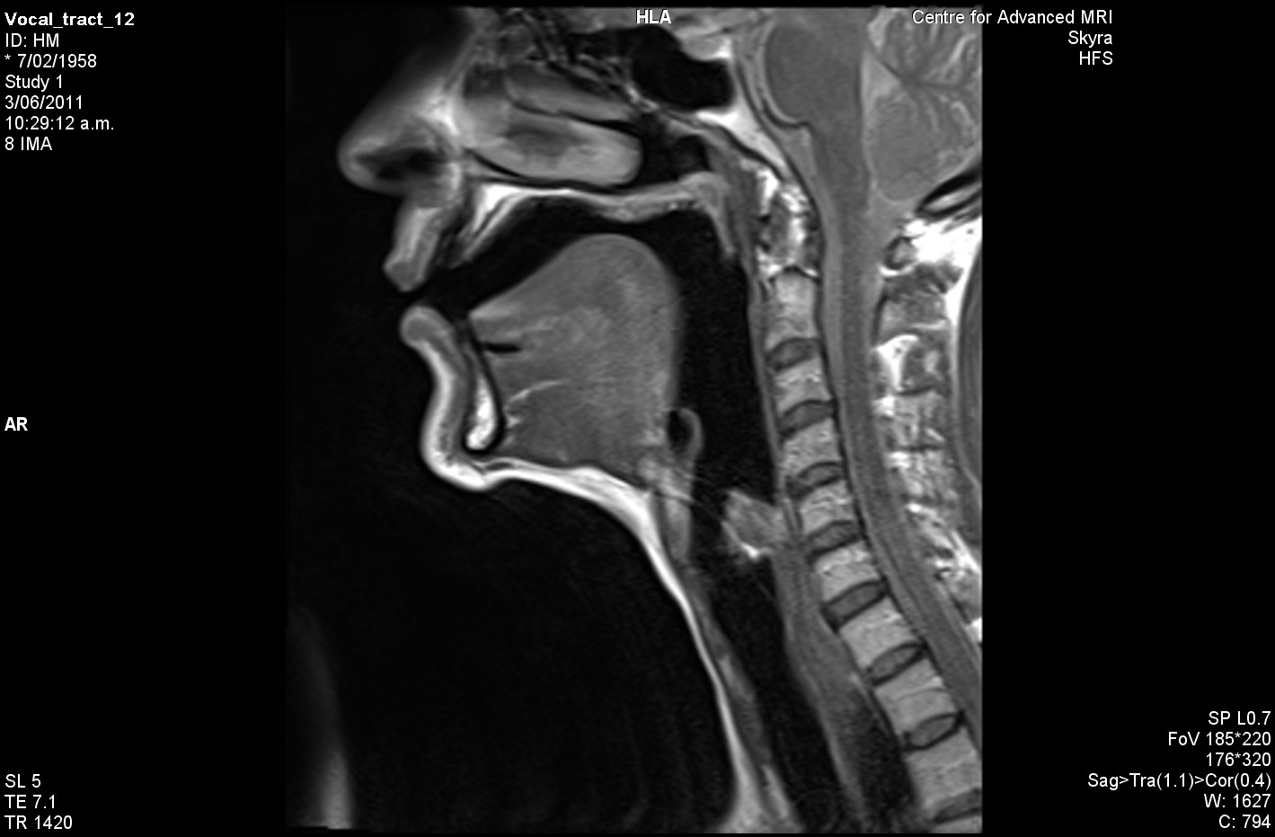
Notes:
WHO”D

